Slide 1
Strategic Success and Outcomes at Columbia College
Presented to the Yosemite Community College District Board of Trustees
Wednesday, April 20, 2022

Slide 2
Strategic Success and Outcomes
Between AY2019-20 and AY2020-21, the college pursued a major re-visioning process to update its strategic goals.
The new goals are more closely aligned to critical guidance and initiatives like the CCC Vision for Success, the Student Equity Plan, and ACCJC accreditation standards.
Starting in AY2021-22, Cambridge West Partnership has provided guidance to translate the goals into a fleshed out strategic plan that is reasonably in line with CS and MJC, while respecting Columbia’s own mission and core values.

Slide 3
Strategic Success and Outcomes
Strategic Goals
Increase Award Completion
Increase Transfer Readiness
Reduce Barriers to Completion
Increase Workforce Readiness
Reduce Equity Gaps
Maintain Institutional Stability

Slide 4
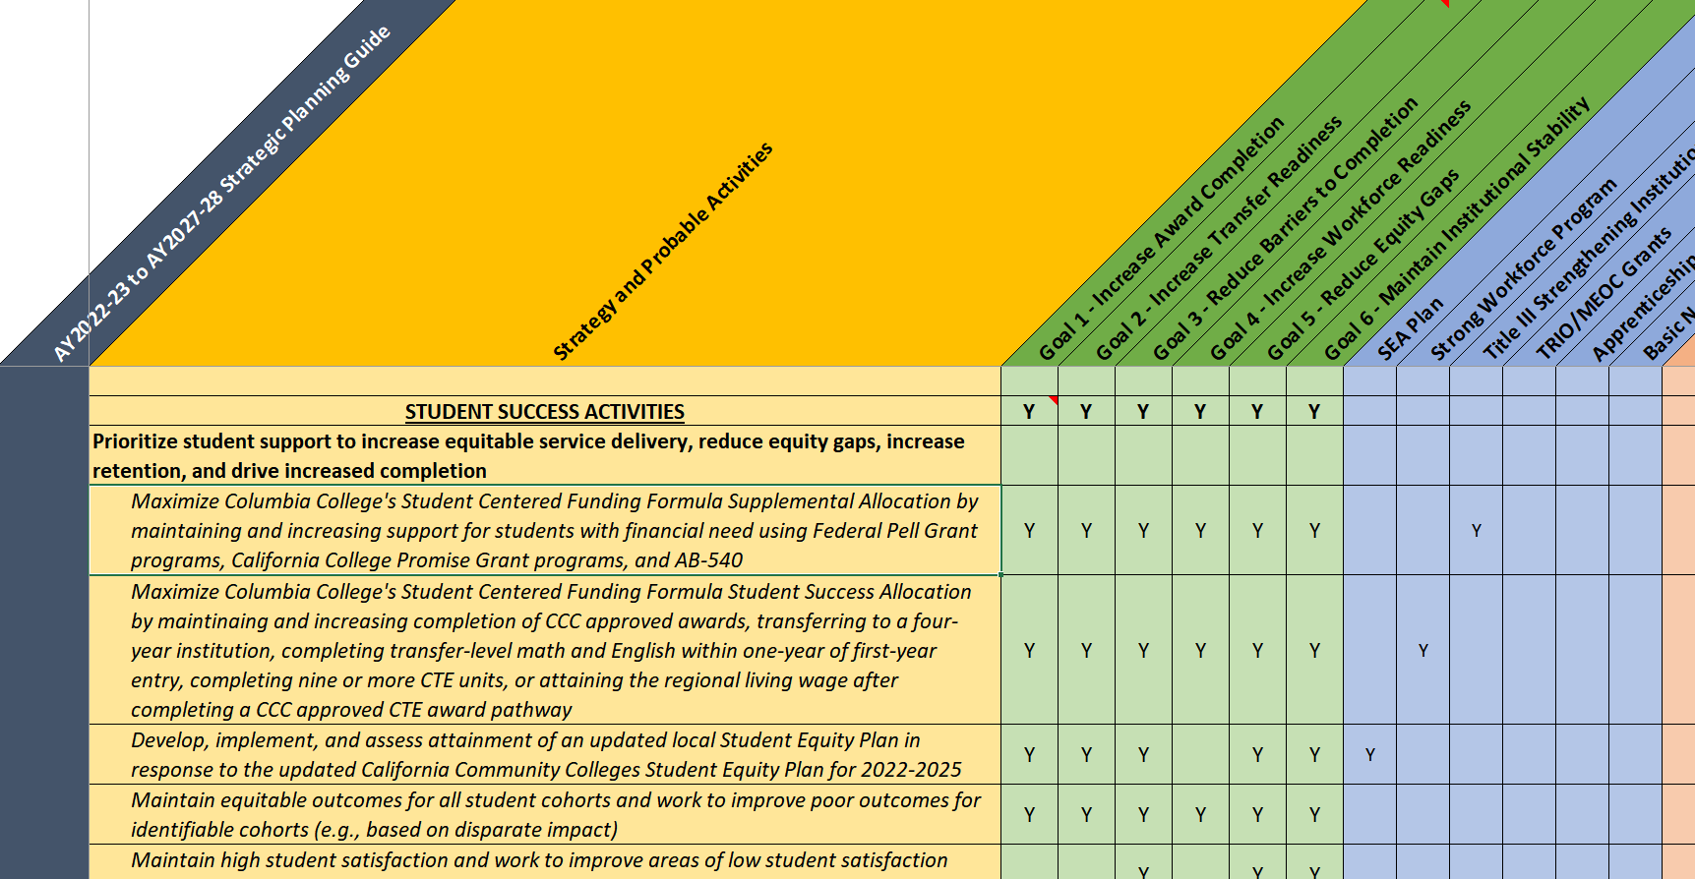
Strategic Success and Outcomes
The working strategic plan is built around a planning guide that lists general strategies to achieve the college’s goals, and possible activities it will do to meet them.
Exhibit. Partial screen-snip of the college’s draft strategic planning guide

Slide 5
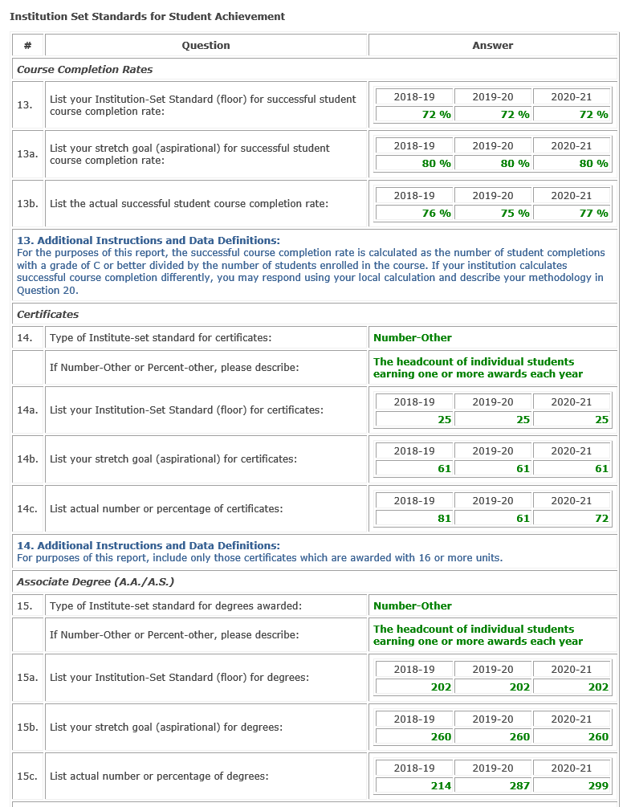
Strategic Success and Outcomes
Goal attainment will be informed by benchmarks and reporting that the college already does, like its annual accreditation report (right).
At a top-line, if the college continues to meet its established benchmarks while pursuing strategic objectives and activities, there is reason to believe that it’s strategies are working, if only implicitly.
Not meeting objectives implies a need to examine areas of ineffectiveness starting with the question are we doing what we said we were going to do?
Exhibit. Partial screen-snip of Institution Set Standards compiled for the college’s annual accreditation report

Slide 6
Strategic Success and Outcomes
Other goals, particularly those around Goal 6. Maintain Institutional Stability, are developed and informed by more comprehensive activities. For example:
Objective 6.2 – Balance larger and smaller classes to increase enrollment stability. This objective requires intensive and sustained expertise from the college’s instructional team to maximize FTES while maintaining the most value to students.
Objective 6.3 – Increase fiscal transparency. A set of implementation goals that includes the establishment of a new committee to prioritize program review resource requests, and a collegewide assessment of transparency informed by an ongoing biennial survey.
Objective 6.6 – Expand community partnerships. An implementation goal that will evolve organically and have demonstrable impacts on college activities.

Slide 7
Strategic Success and Outcomes
The college, in collaboration with Cambridge West Partnerships, has developed a working, though very preliminary, draft strategic plan.
The draft and its components were reviewed and approved by the college’s Institutional Effectiveness Council in its March and April 2022 meetings.
The draft was tabled for review at the April 2022 College Council meeting in anticipation of a more complete product.
A small writing team will continue to develop the plan over the summer in anticipation of providing a final draft to both the IEC and College Council in early Fall 2022 to begin a formal reading.

Slide 8
Strategic Success and Outcomes
Student Success Council
Discusses and drives initiatives to improve student outcomes.
A critical component of the college’s participatory decision-making structure.
Is currently anticipating updated data and benchmarking-guidance for the Student Equity Plan.

Slide 9
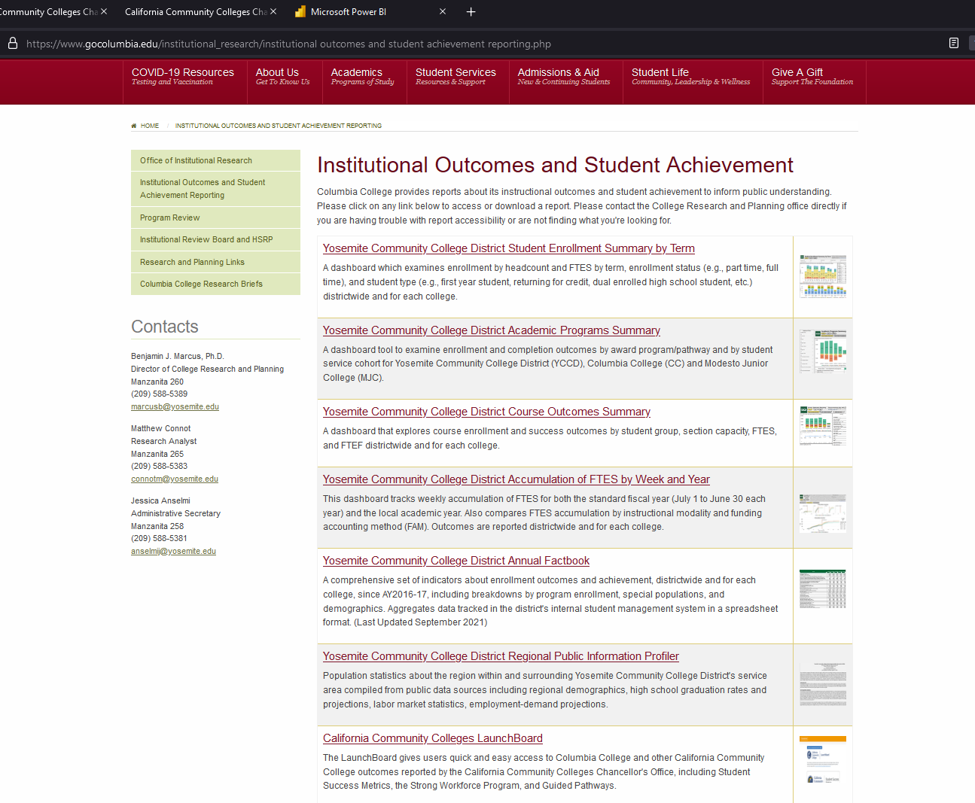
Strategic Success and Outcomes
Public-Facing Student Achievement Data
Summarizes outcomes for YCCD and each college.
Also provides a hub to access critical CCC and other resources.
A public service as well as internal use
Helps to meet integrated planning and accreditation standards

Slide 10
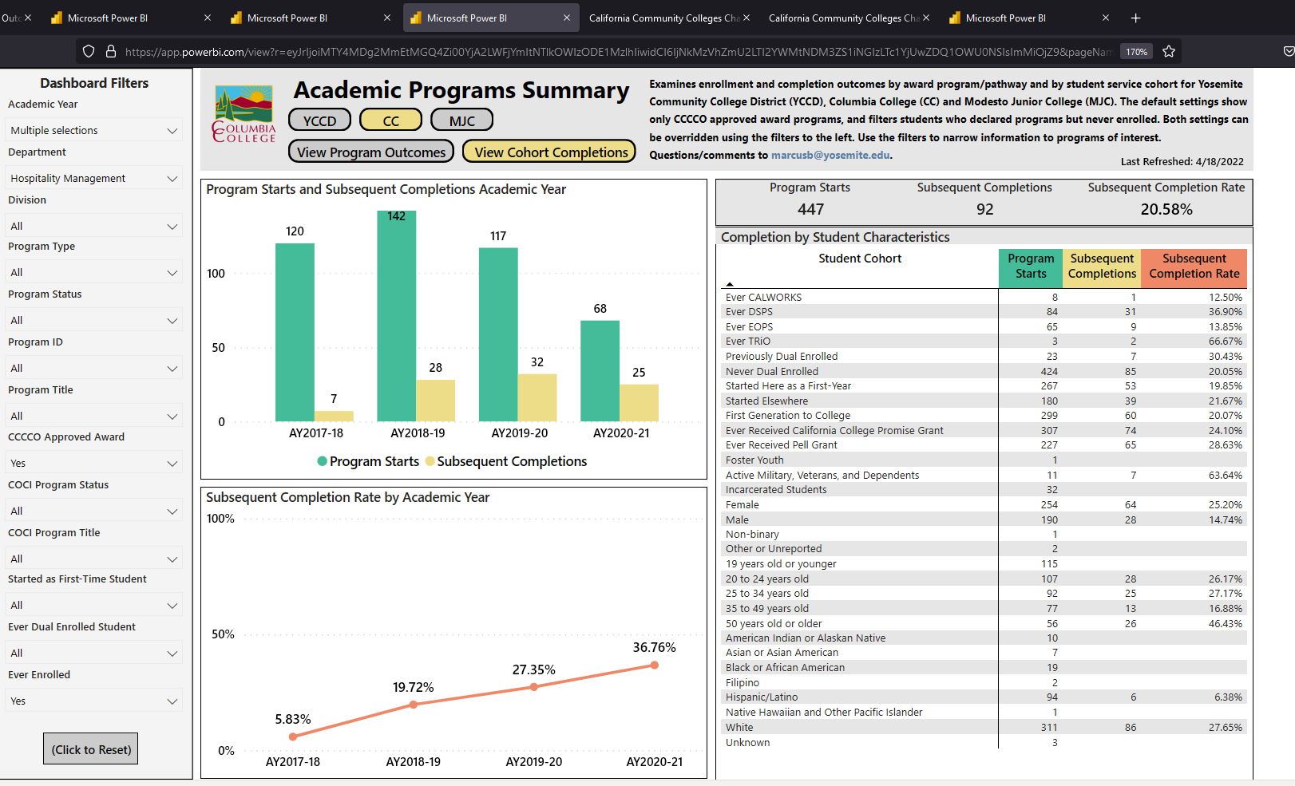
Strategic Success and Outcomes
A Success Story
Intrusive advising (Guided Pathways), smart program declaration policies, and likely a bit of Covid-19 pandemic, helped increase completion rates for Hospitality Management
It didn’t generate more program starts, but helped to limit tangential enrollments and allowed faculty to focus on their core students

Slide 11
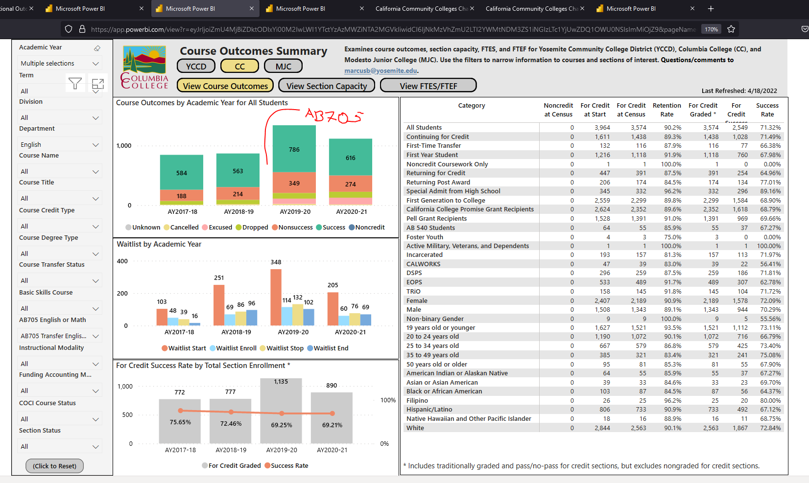
Strategic Success and Outcomes
A Success Story
Aligning enrollment practices to AB705 (and/or a Covid-19 pandemic) yielded a few percentage points decline in success rate for transfer-English
But the absolute headcount of students both attempting and completing English increased substantially

